Slide 1

Stream Bioassessments, Part B
Learning Module #17

Slide 2
Agenda
Time | Length | Activity
9:00 | 15 min | Opening Activity
9:15 | 20 min | Macroinvertebrate Collection Methods
9:35 | 15 min | Why is collection standardization important?
9:50 | 10 min | BREAK
10:00 | 2 hours | Campus Stream Macroinvertebrate Collection and ID
12:00 | 30 min | Campus Stream Macroinvertebrate Bioassessment

Slide 3
Opening Activity
For the opening activity, we are going to watch a short video about a youth science trip on the Colorado River.
In the video, you’ll see the students collecting both macroinvertebrate and fishes. Note the tools and methods they are using to collect these organisms…. this is what we’ll be doing today in our campus stream!

Slide 4
Opening Activity
Video: What You Take Away (Freshwaters Illustrated)
https://www.freshwatersillustrated.org/what-you-take-away

Slide 5
Opening Activity: Discussion Questions
What kind of tools and methods did you use the youth scientists use to collect macroinvertebrates? What about fishes?

Slide 6
Opening Activity: Discussion Questions
What kind of tools and methods did you use the youth scientists use to collect macroinvertebrates? What about fishes?
Did it surprise you that macroinvertebrates can also be found in large rivers, like the Colorado River, as well as small streams?

Slide 7
Opening Activity: Discussion Questions
What kind of tools and methods did you use the youth scientists use to collect macroinvertebrates? What about fishes?
Did it surprise you that macroinvertebrates can also be found in large rivers, like the Colorado River, as well as small streams?
Was there anything that surprised you in this video?

Slide 8
Opening Activity: Discussion Questions
What kind of tools and methods did you use the youth scientists use to collect macroinvertebrates? What about fishes?
Did it surprise you that macroinvertebrates can also be found in large rivers, like the Colorado River, as well as small streams?
Was there anything that surprised you in this video?
What other observations or questions do you have after watching this video?

Slide 9
Macroinvertebrate Collection Methods
Today, we are going to be collecting and identifying macroinvertebrates from our campus stream!
Before we head out to the stream, we need to learn methods for how to collect macroinvertebrates.
Feel free to take notes as you please!

Slide 10
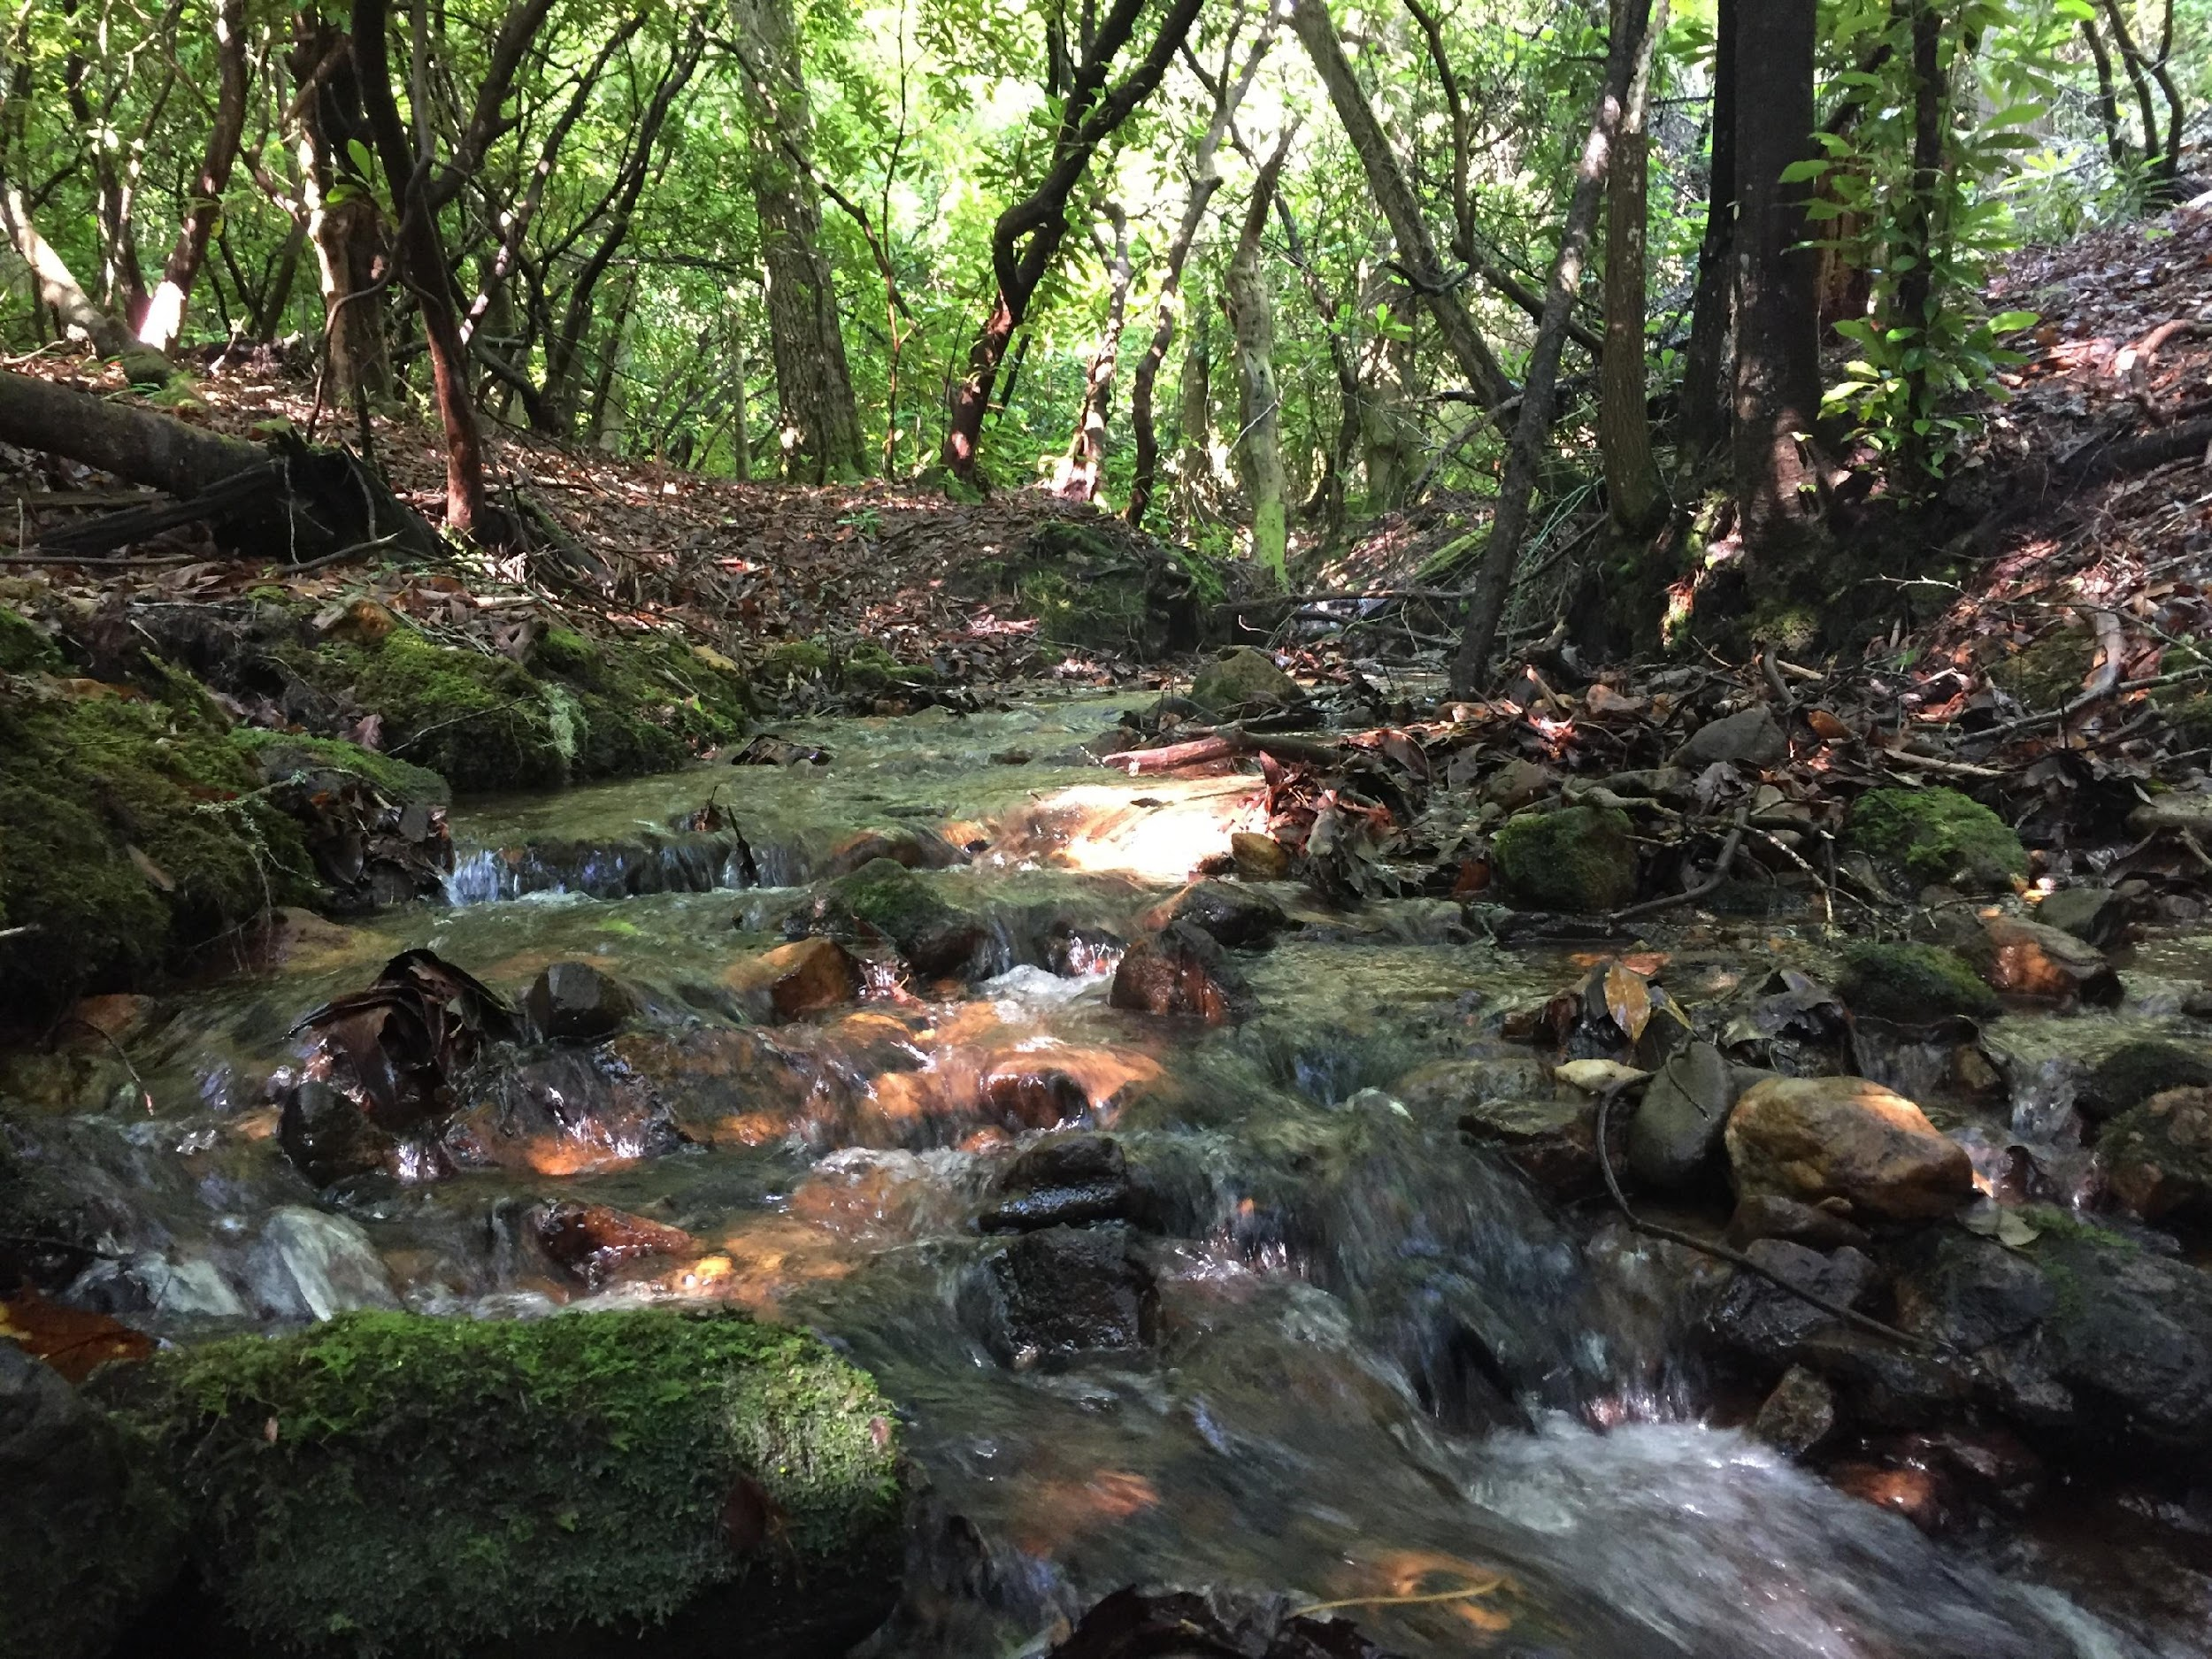
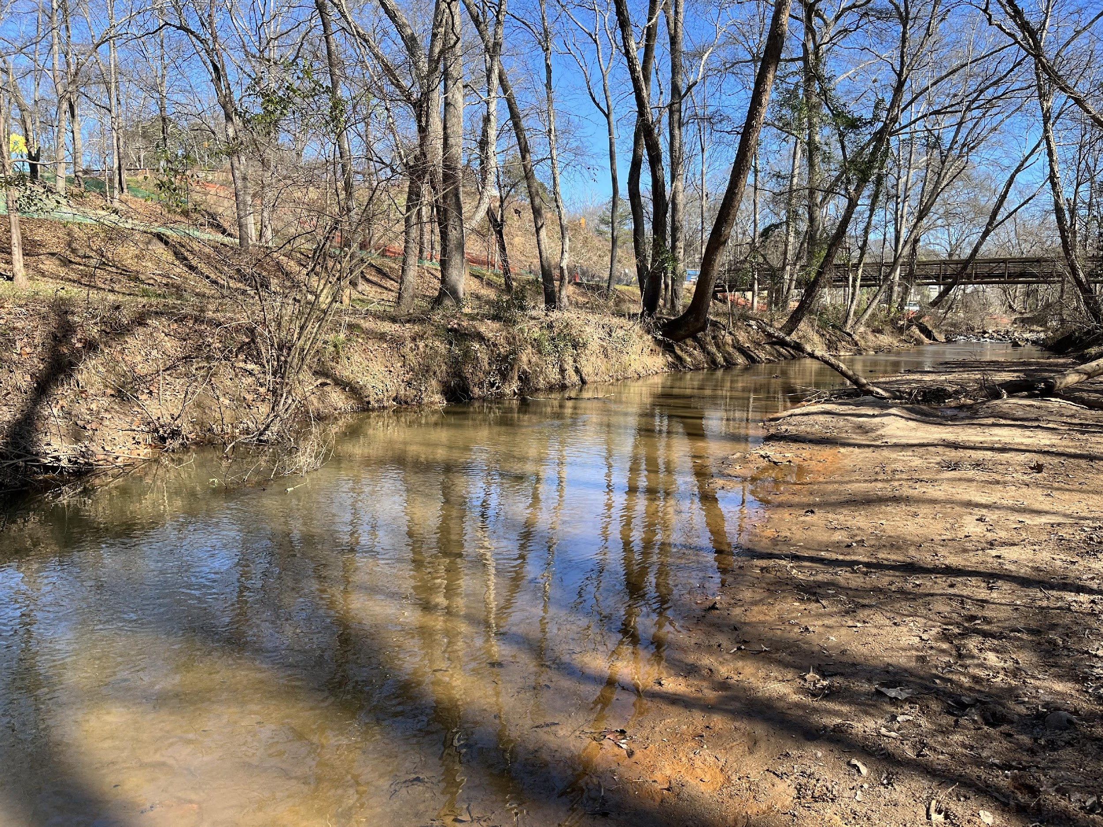
Macroinvertebrate Collection Methods
STREAM TYPES
1. Rocky Bottom Streams
Generally found in North GA and Piedmont Region
Characterized by fast moving water flowing over large rocks and boulders
Stream stretch consist of pool/riffle system
2. Muddy Bottom Streams
Found mostly in South GA and urban environments due to erosion and sedimentation
Slow moving water with little or no turbulence
Substrate is generally composed of fine silt, sand or coarse gravel
If your stream shows traits of both categories, do your best to CHOOSE ONE and proceed with that method!

Slide 11
Macroinvertebrate Collection Methods
STREAM TYPES
1. Rocky Bottom Streams
Generally found in North GA and Piedmont Region
Characterized by fast moving water flowing over large rocks and boulders
Stream stretch consist of pool/riffle system
2. Muddy Bottom Streams
Found mostly in South GA and urban environments due to erosion and sedimentation
Slow moving water with little or no turbulence
Substrate is generally composed of fine silt, sand or coarse gravel
If your stream shows traits of both categories, do your best to CHOOSE ONE and proceed with that method!
Question: What kind of stream is our campus stream – rocky bottom or muddy bottom?

Slide 12
Macroinvertebrate Collection Methods
HABITAT TYPES
1. Vegetative margins - area along the edge of water body consisting of overhanging bank vegetation
2. Substrate
Sand/rock/gravel streambed - area of stream with coarse substrate
Riffles - shallow area of a stream in which water flows rapidly over a rocky or gravelly stream bed
3. Organic Matter
Leaf packs – decomposing vegetation that is submerged in the water
Woody debris – decomposing trees, roots, or branches that are submerged in the water

Slide 13
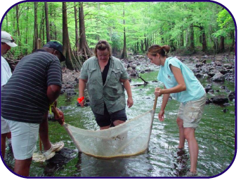
Macroinvertebrate Collection Methods
Rocky Bottom Streams
Sample TWO different habitats using a kick seine
Substrate – 3 samples
Sample 2x2 foot area with kick seine net in riffle areas
Organic matter – 4 samples
Using both hands, take 4 handfuls (1 square foot) of decayed, submerged leaf packs
Image: Georgia Adopt-A-Stream

Slide 14
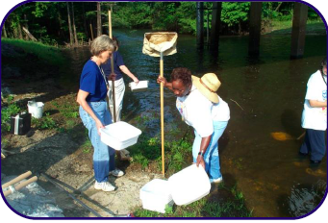
Macroinvertebrate Collection Methods
Muddy Bottom Streams
Sample THREE different habitats using a D-frame net.
Vegetative Margins -- 7 Samples
7 scoops (1 square foot)
Organic Matter -- 4 samples
4 scoops (1 square foot) in woody debris
Substrate -- 3 samples
3 scoops (1 square foot) of sand/rock/gravel or coarsest area of streambed
Tip: Try to avoid collecting a lot of sand to save time
Image: Georgia Adopt-A-Stream

Slide 15
Why is collection standardization important?
Working with a partner, take 5 minutes to brainstorm reasons why standardization of macroinvertebrate collection methods is important. (In other words, why it is important that all muddy bottom streams receive the same number of samples of each habitat type?)
Write down your ideas on your lesson worksheet.

Slide 16
Why is collection standardization important?
Share out your ideas with the class!

Slide 17
Take
a
break!

Slide 18
Stream Macroinvertebrate Collection and ID
Next, we are going to be collecting and identifying macroinvertebrates (using the Adopt-A-Stream protocols) at our campus Stream.
You will need:
Forceps
Collecting tray
Pencil(s)
Water boots
Rite in Rains
Clear plastic cups or similar (to aid with sorting)
Adopt-A-Stream Macroinvertebrate Bioassessment Form (page 1 ONLY)
You and your partner will need (between the two of you):
Bucket
D-Net or Kick Seine (depending on stream type)
Seine
Macroinvertebrate ID Binder

Slide 19
Stream Macroinvertebrate Collection and ID
Note:
We will be filling out Page 1 (Site Info/ Weather/ Observations) at the site, but we will be waiting until we get back to the classroom to fill out Page 2 (Macro Bioassessment).
So, you and your partner should be collecting ID data (i.e., what macroinvertebrates you have and how many) in your Rite-in-Rains!
When we get back to the classroom, we will compile all our data together so that we can complete Page 2.
Next, we are going to be collecting and identifying macroinvertebrates (using the Adopt-A-Stream protocols) at our campus Stream.
You will need:
Forceps
Collecting tray
Pencil(s)
Water boots
Rite in Rains
Clear plastic cups or similar (to aid with sorting)
Adopt-A-Stream Macroinvertebrate Bioassessment Form (page 1 ONLY)
You and your partner will need (between the two of you):
Bucket
D-Net or Kick Seine (depending on stream type)
Sieve
Macro ID Binder

Slide 20
Data sheet set-up (example)
Researchers:
Stream name:
Date:
Time:
Description | ID | Tally/Count
Long and skinny, has rock case | Caddisfly | IIII
Has three ”tails” - brown in color | Mayfly | IIIII II
Looks like a penny | Water penny | II

Slide 21
Campus Stream Macroinvertebrate Bioassessment
1. Each group should bring their data sheet to the instructor so that the instructor can compile ALL the macroinvertebrate collection data.
2. Once data has been compiled, use the macroinvertebrate collection data to fill out the Macroinvertebrate Bioassessment Form (Page 2).

